Slide 1

Twofish[es]

Slide 2
What are twofishes?

Slide 3
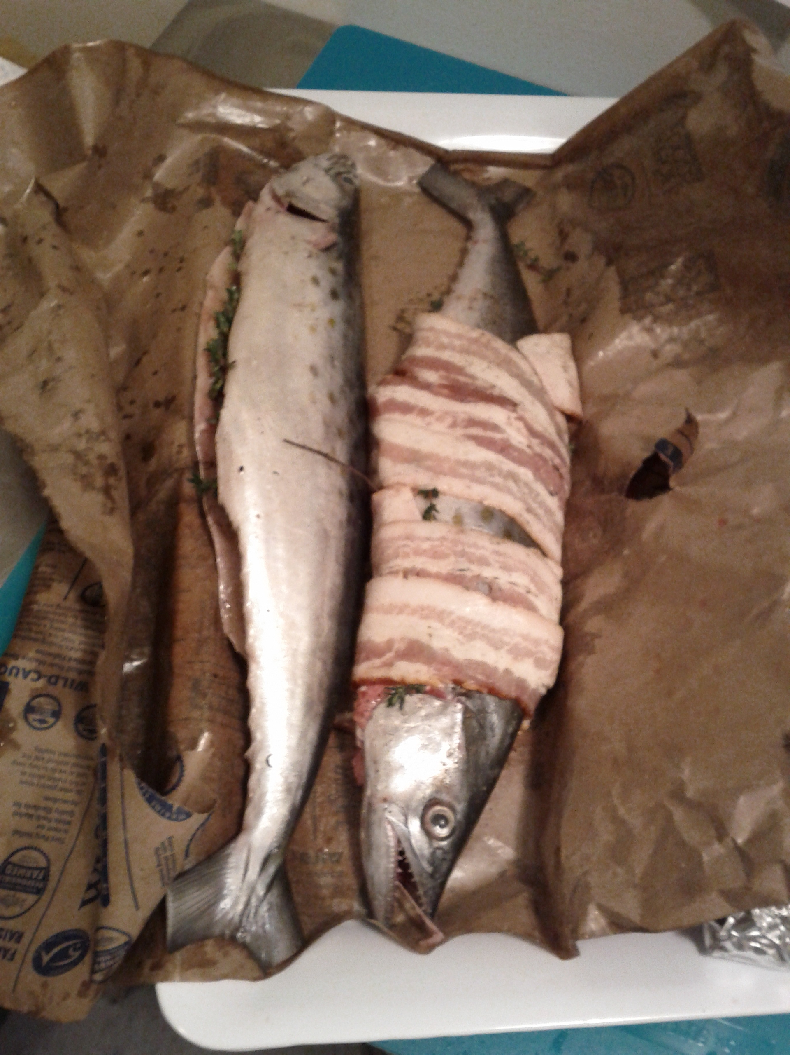
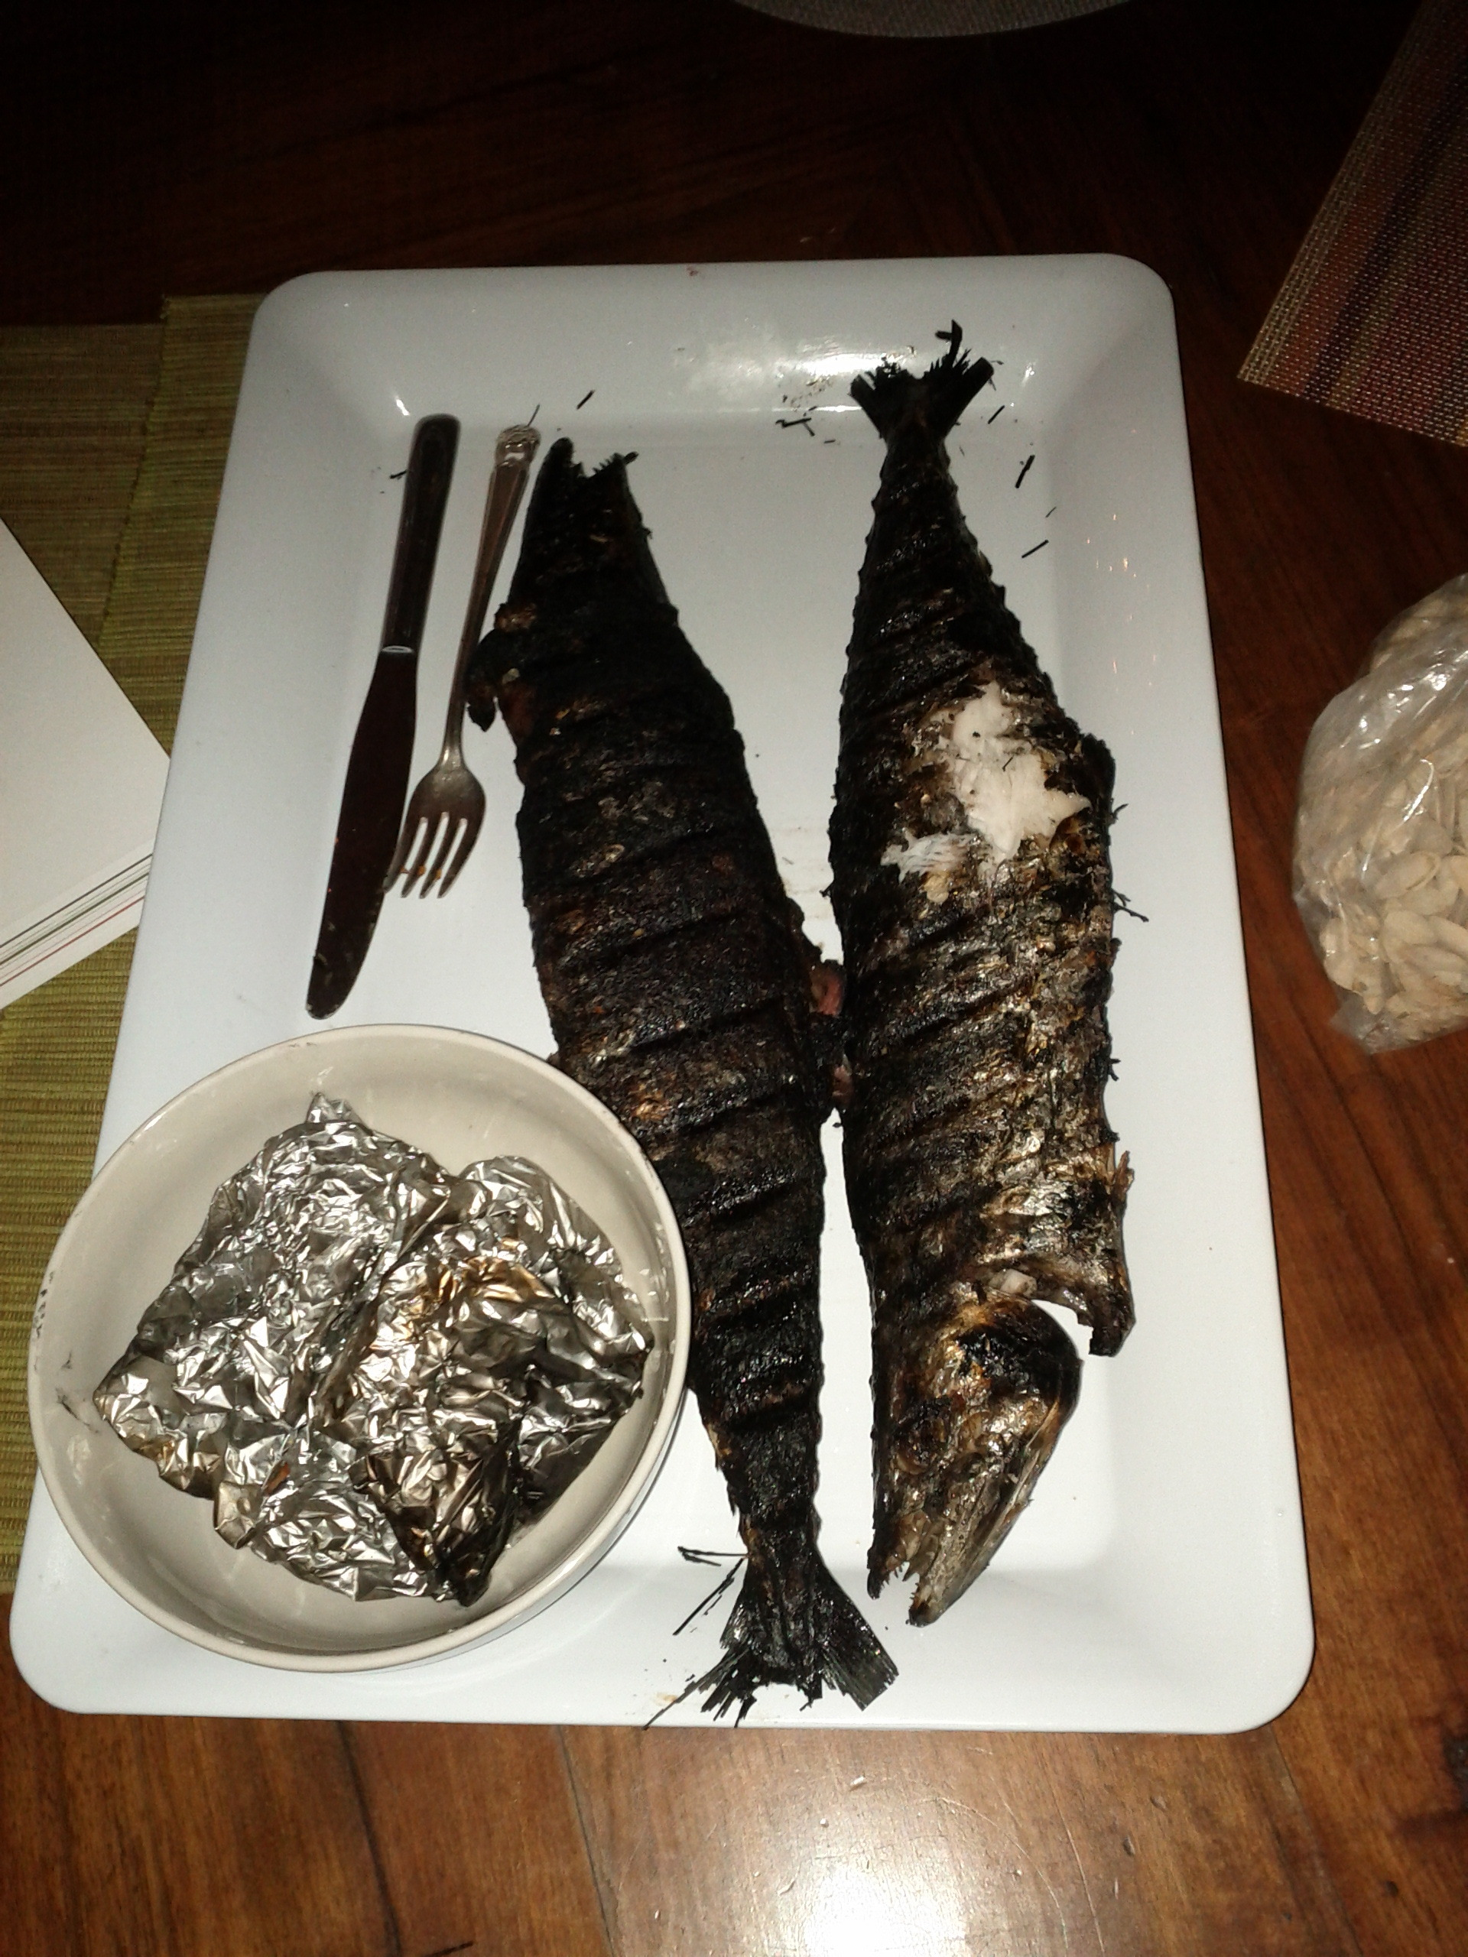

Slide 4
A coarse geocoder from Foursquare
City/neighborhood/POI level
In-memory
Fast?
Splitting
  pizza new york -> pizza near [40.74,-74]

Slide 5
Based on open data

Slide 6
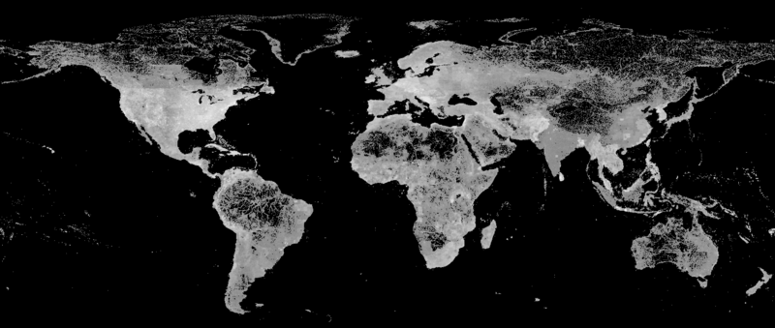
Geonames
CC-BY (Attribution)

Slide 7
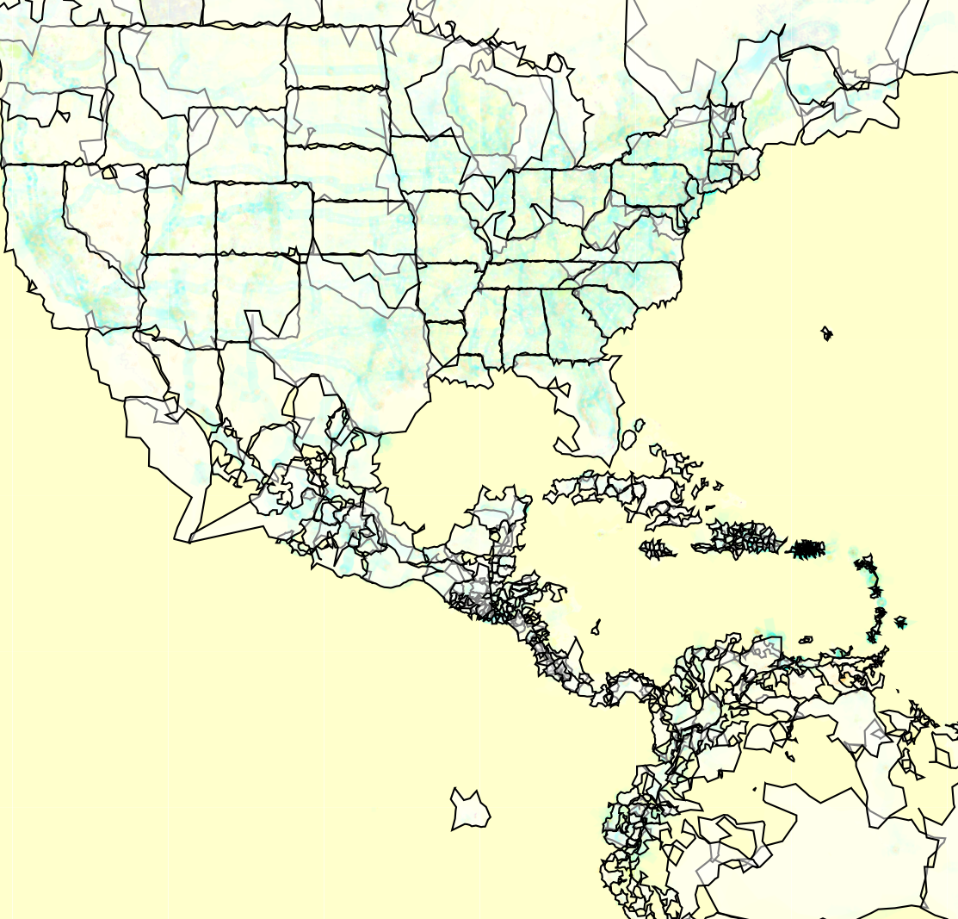
Flickr
Public Domain

Slide 8
Foursquare <3 OSM
coming soon.

Slide 9
Algorithm

Slide 10
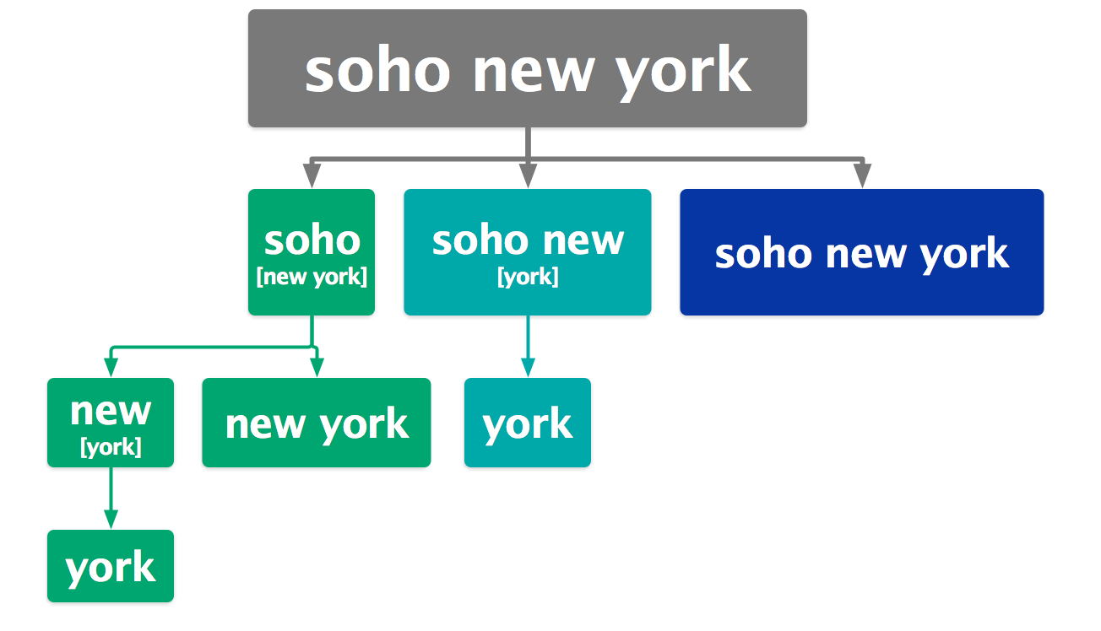
Recursive Descent Parse Tree

Slide 11
[soho] + [new york]

Slide 12
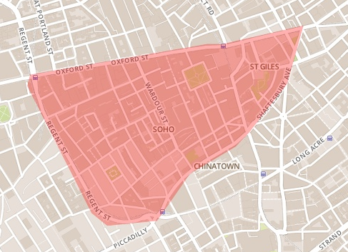
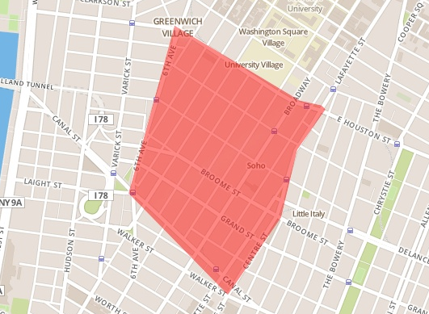
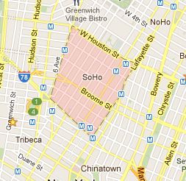
[soho] + [new york]
Soho
parents
  london
  united kingdom
Soho
parents
  new york (city)
  new york (state)
  united states
parents:
  new york (city)
  new york (state)
  united states

Slide 13
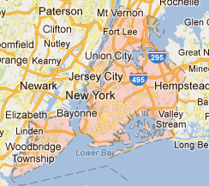
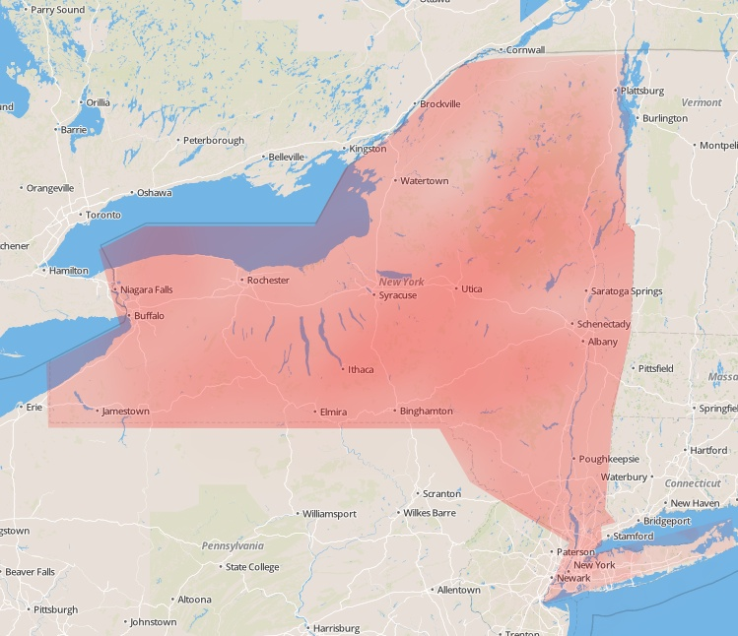
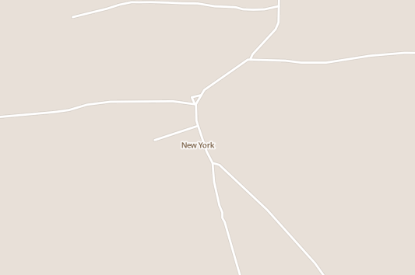
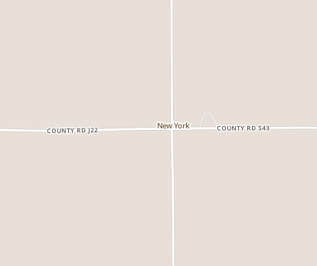
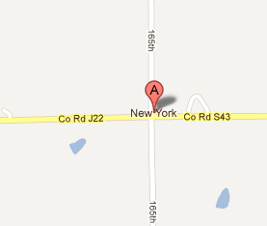
[soho] + [new york]
Soho
New York (city)
New York (state)
parents
  london
  united kingdom
parents
  new york (state)
  united states
parents
  united states
Soho
New York, TX
New York, IA
parents
  new york (city)
  new york (state)
  united states
parents
  texas
  united states
parents
  iowa
  united states
parents:
  new york (city)
  new york (state)
  united states

Slide 14
[soho] + [new york]
Soho
New York (city)
New York (state)
parents
  london
  united kingdom
parents
  new york (state)
  united states
parents
  united states
Soho
New York, TX
New York, IA
parents
  new york (city)
  new york (state)
  united states
parents
  texas
  united states
parents
  iowa
  united states
parents:
  new york (city)
  new york (state)
  united states

Slide 15
[soho] + [new york]
Soho
New York (city)
New York (state)
parents
  london
  united kingdom
parents
  new york (state)
  united states
parents
  united states
Soho
New York, TX
New York, IA
parents
  new york (city)
  new york (state)
  united states
parents
  texas
  united states
parents
  iowa
  united states
parents:
  new york (city)
  new york (state)
  united states

Slide 16
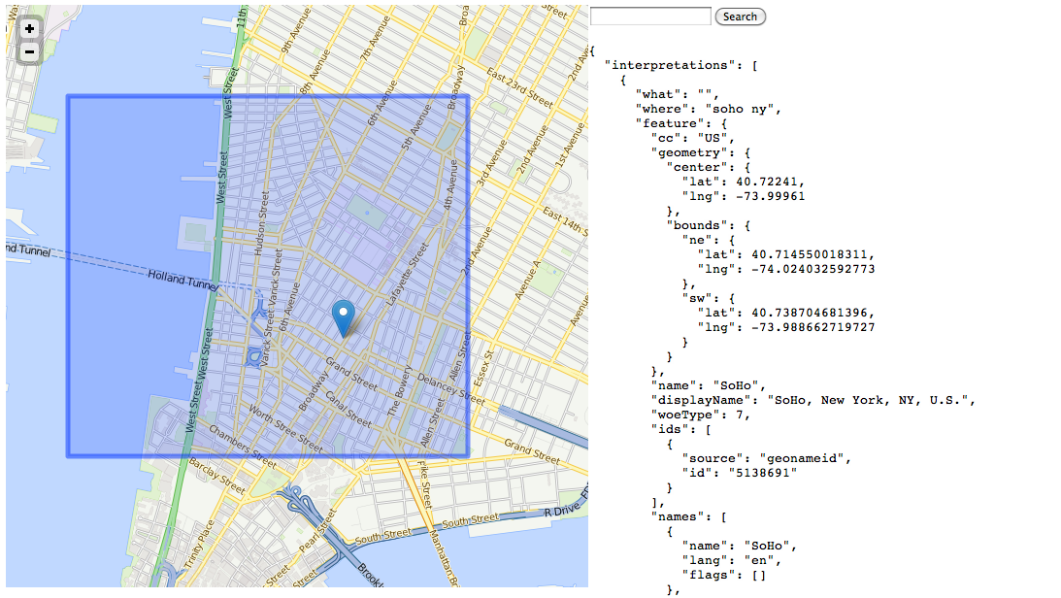
Done!

Slide 17

Postal Codes = Hack

Slide 18
Launching Thursday!

Slide 19
In our API
https://foursquare.com/v2/venues/search
?query=pizza&ll=40.74,-74
https://foursquare.com/v2/venues/search
?query=pizza&near=nyc

Slide 20
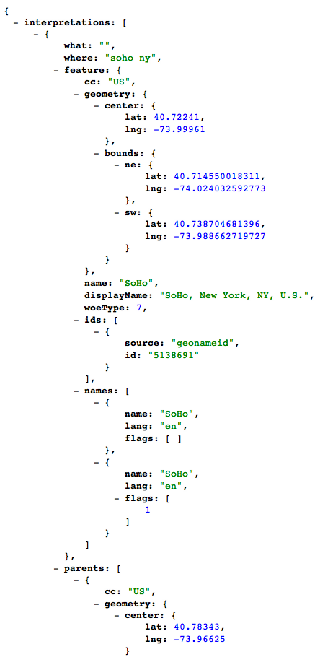
Hosted in our API
https://foursquare.com/v2/geo/geocode?query=nyc
Limited release while we tweak the API
Email blackmad@foursquare.com for access

Slide 21
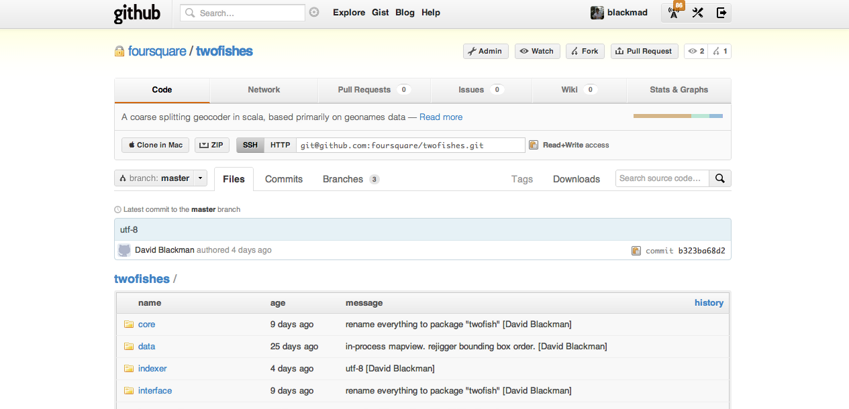
Open Sourced
http://github.com/foursquare/twofishes

Slide 22
Office Hours @ 4:15 (now!)

Slide 23
Thank You blackmad@foursquare.com foursquare.com

Slide 24
References
http://geonames.org/
http://code.flickr.com/blog/2011/01/08/flickr-shapefiles-public-dataset-2-0/

